Slide 1
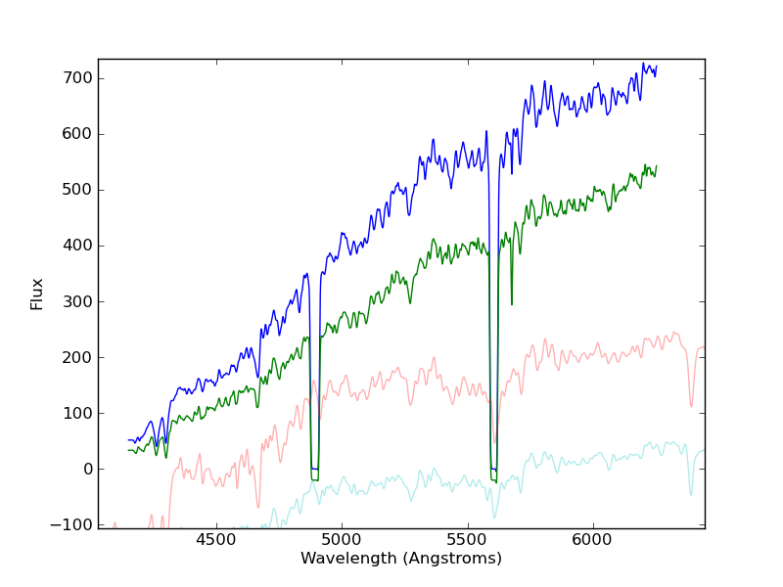
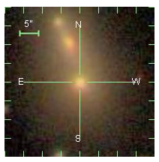
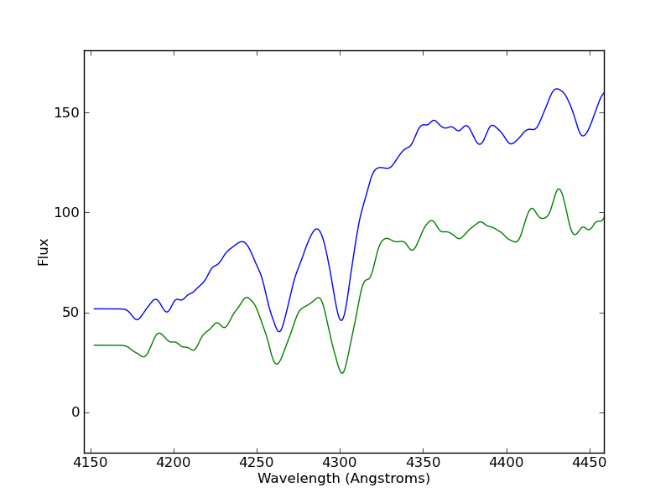
The growth of Brightest Cluster Galaxies through mergers.
D.N. Viljoen D. Gilbank S.I. Loubser
Using the RSS longslit (with PG 1300 grating) to determine accurate relative velocity differences between merging candidates.
SALT
Verification of the technique on nearby SDSS merger.
z ~ 0.08
∆V = 2.0 ± 37.0 km/s
SDSS

Slide 2
S/N in RSS observations is factor of ~2 lower than predicted by
RSS simulator (using v3.91).
15 min exposure on RSS is approx. equivalent to a 45 min SDSS exposure.
Pilot project of 10 galaxies awarded time.
4 galaxies observed.
- 3 not useable due to poor slit alignment and SALTICAM problems.

